Slide 1
Alzheimer’s Research 2023
Paul Martino, Kara Dawson, Emma Ryan, Abigail Wheeler, William Valentine

Slide 2
Introduction

Slide 3
As of 2020, 5.8 million Americans were living with Alzheimer’s Disease¹
This number is expected to nearly triple to 14 million by 2060¹
¹Center for Disease Control and Prevention. (2020, October 26). What is alzheimer's disease? Centers for Disease Control and Prevention. Retrieved July 20, 2022, from https://www.cdc.gov/aging/aginginfo/alzheimers.htm

Slide 4
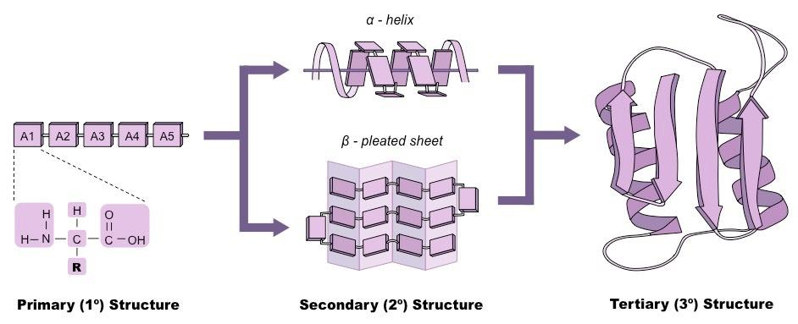
Protein Summary…
DNA → RNA → PROTEINS
https://r.search.yahoo.com/_ylt=AwrNOZV8kcxi6RkABfqjzbkF;_ylu=c2VjA2ZwLWF0dHJpYgRzbGsDcnVybA--/RV=2/RE=1657602556/RO=11/RU=https%3a%2f%2fwww.easynotecards.com%2fnotecard_set%2f117932/RK=2/RS=K4fP_attnuUMSCWX.3N8WKrOmdk-

Slide 5
What is Alzheimer’s Disease?
Amyloid Cascade Hypothesis¹
Aβ 42 → High Order Oligomers → Amyloid Plaques
TAU Hyperphosphorylation
TAU → Hyperphosphorylation → NFTs
¹Ricciarelli, R., & Fedele, E. (2017). The amyloid cascade hypothesis in alzheimer's disease: It's time to change our mind. Current neuropharmacology. Retrieved July 20, 2022, from https://www.ncbi.nlm.nih.gov/pmc/articles/PMC5652035/

Slide 6
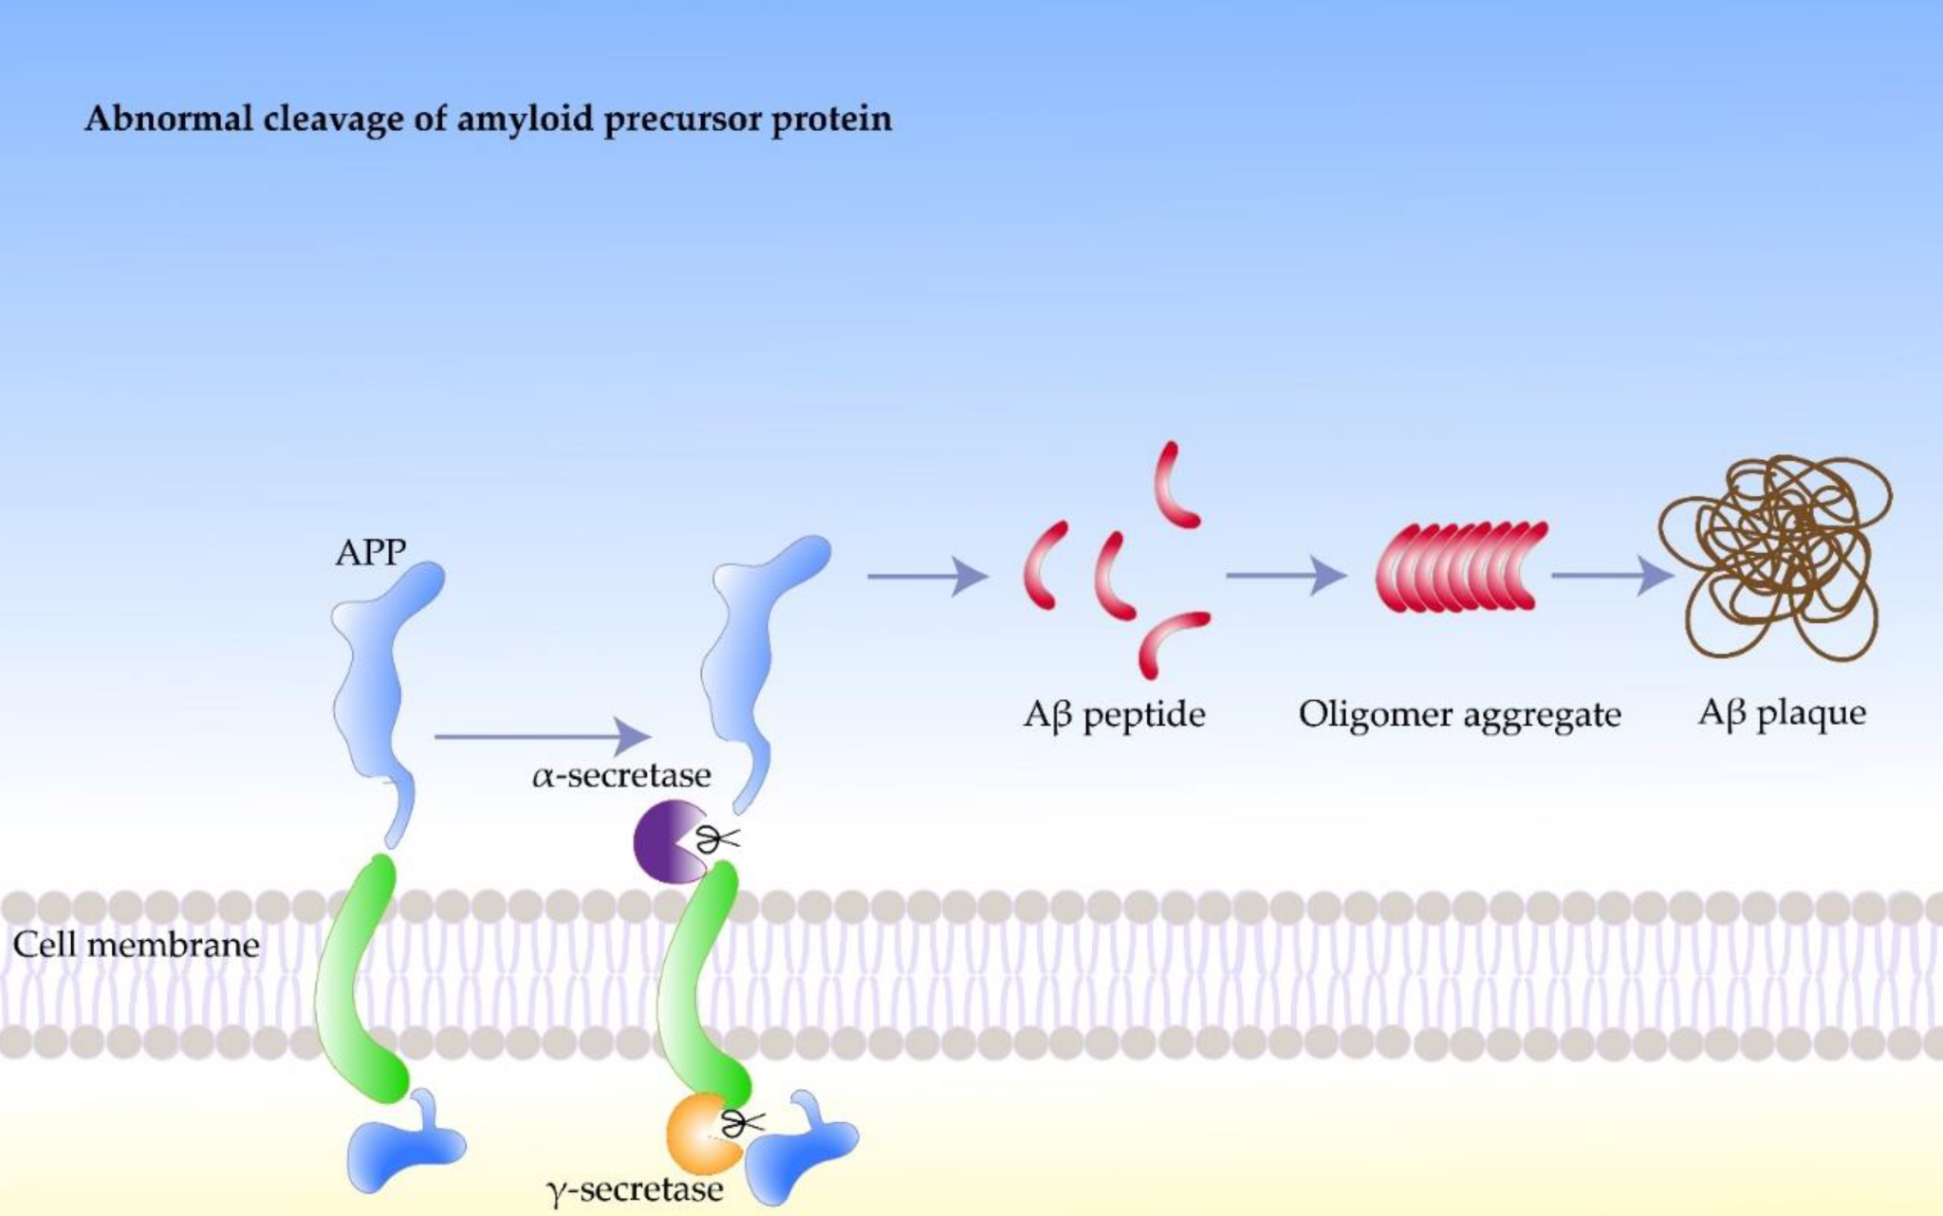
Ma, C. (2022, February 21). Amyloidosis in alzheimer's disease. Encyclopedia. Retrieved July 20, 2022, from https://encyclopedia.pub/entry/19662

Slide 7
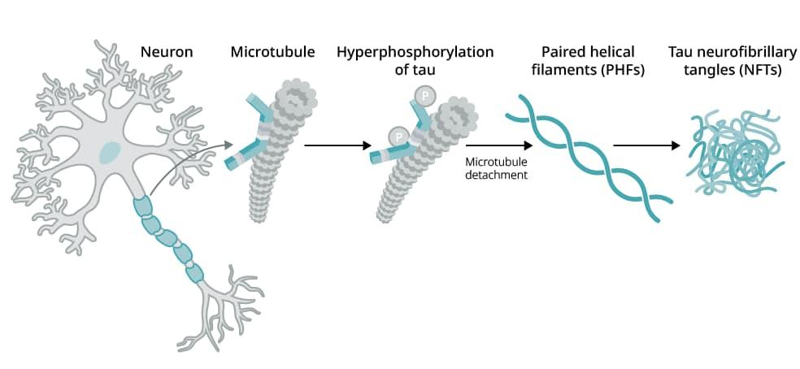
Tau protein aggregation assay relevance to alzheimer’s disease and Tauopathies Research. Neuroscience from Technology Networks. (n.d.). https://www.technologynetworks.com/neuroscience/application-notes/tau-protein-aggregation-assay-relevance-to-alzheimers-disease-and-tauopathies-research-326535

Slide 8
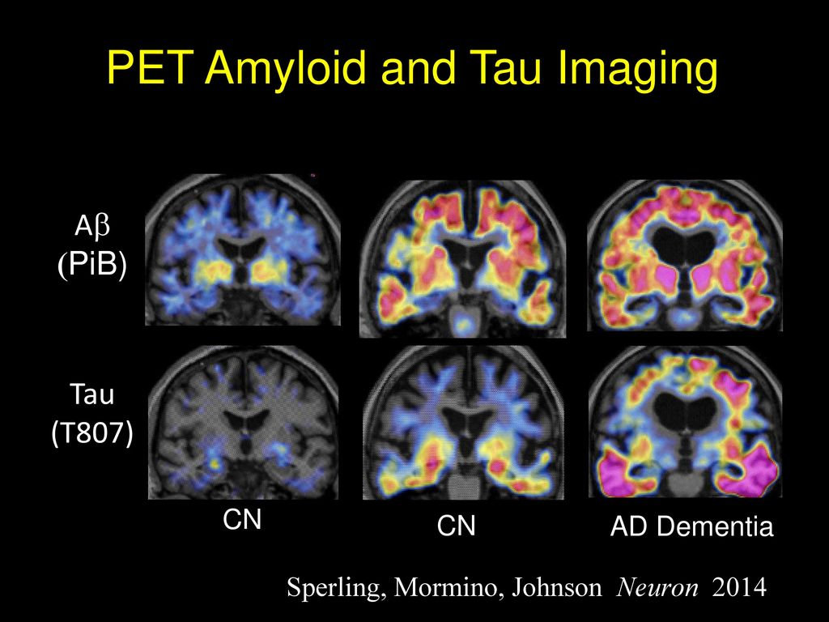
Sperling, R., Mormino, E., & Johnson, K. (2014, November 5). The evolution of preclinical alzheimer's disease: Implications for prevention trials. Neuron. Retrieved July 20, 2022, from https://www.ncbi.nlm.nih.gov/pmc/articles/PMC4285623/

Slide 9
Hypothesis:
FDA approved kinase inhibitors can inhibit both the aggregation of Aβ 42 and the hyperphosphorylation of Tau.

Slide 10
Methodology/Results

Slide 11
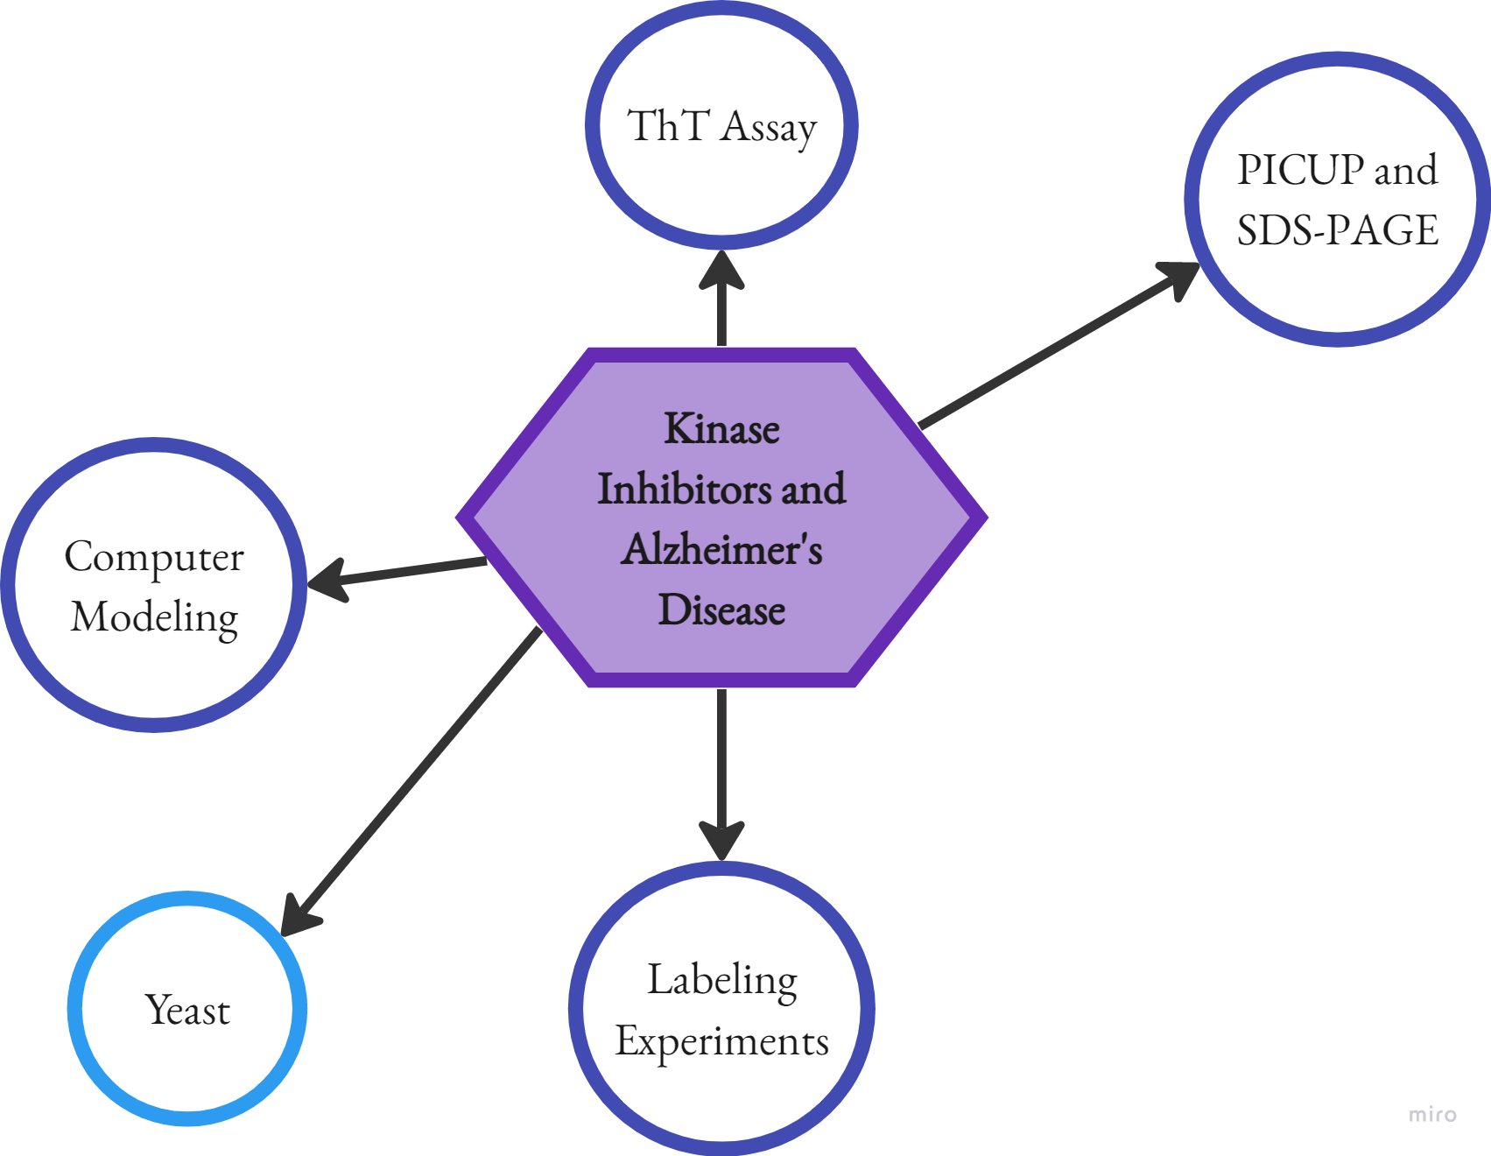
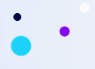

Slide 12
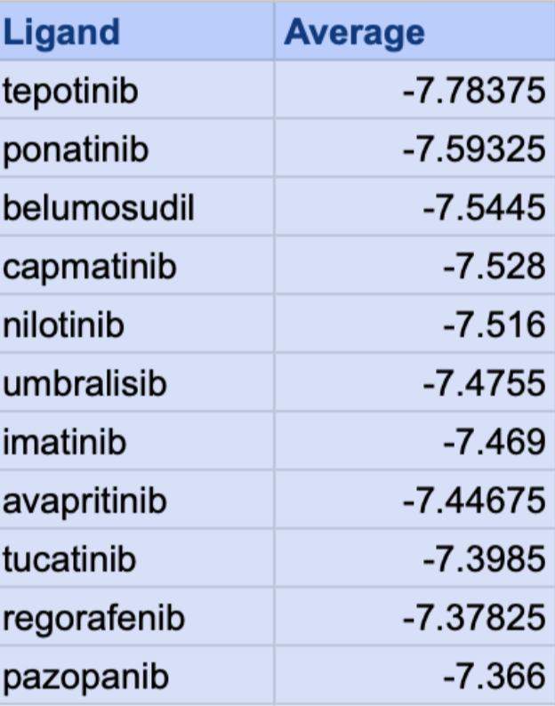


Autodock Vina
Models Protein-ligand binding patterns
Preliminary search for kinase inhibitors
(kcal/mol)

Slide 13
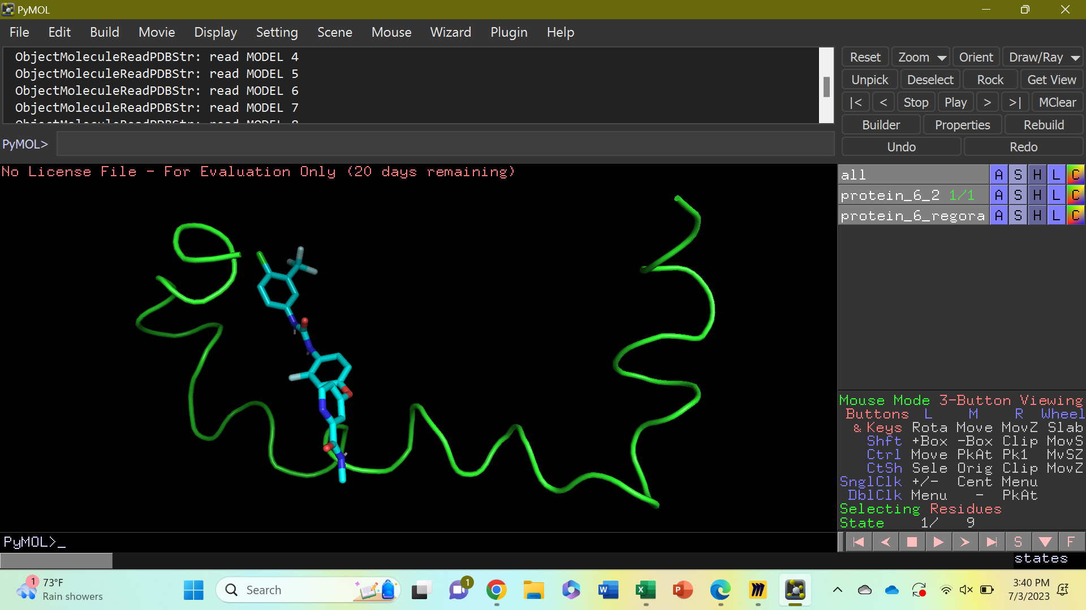
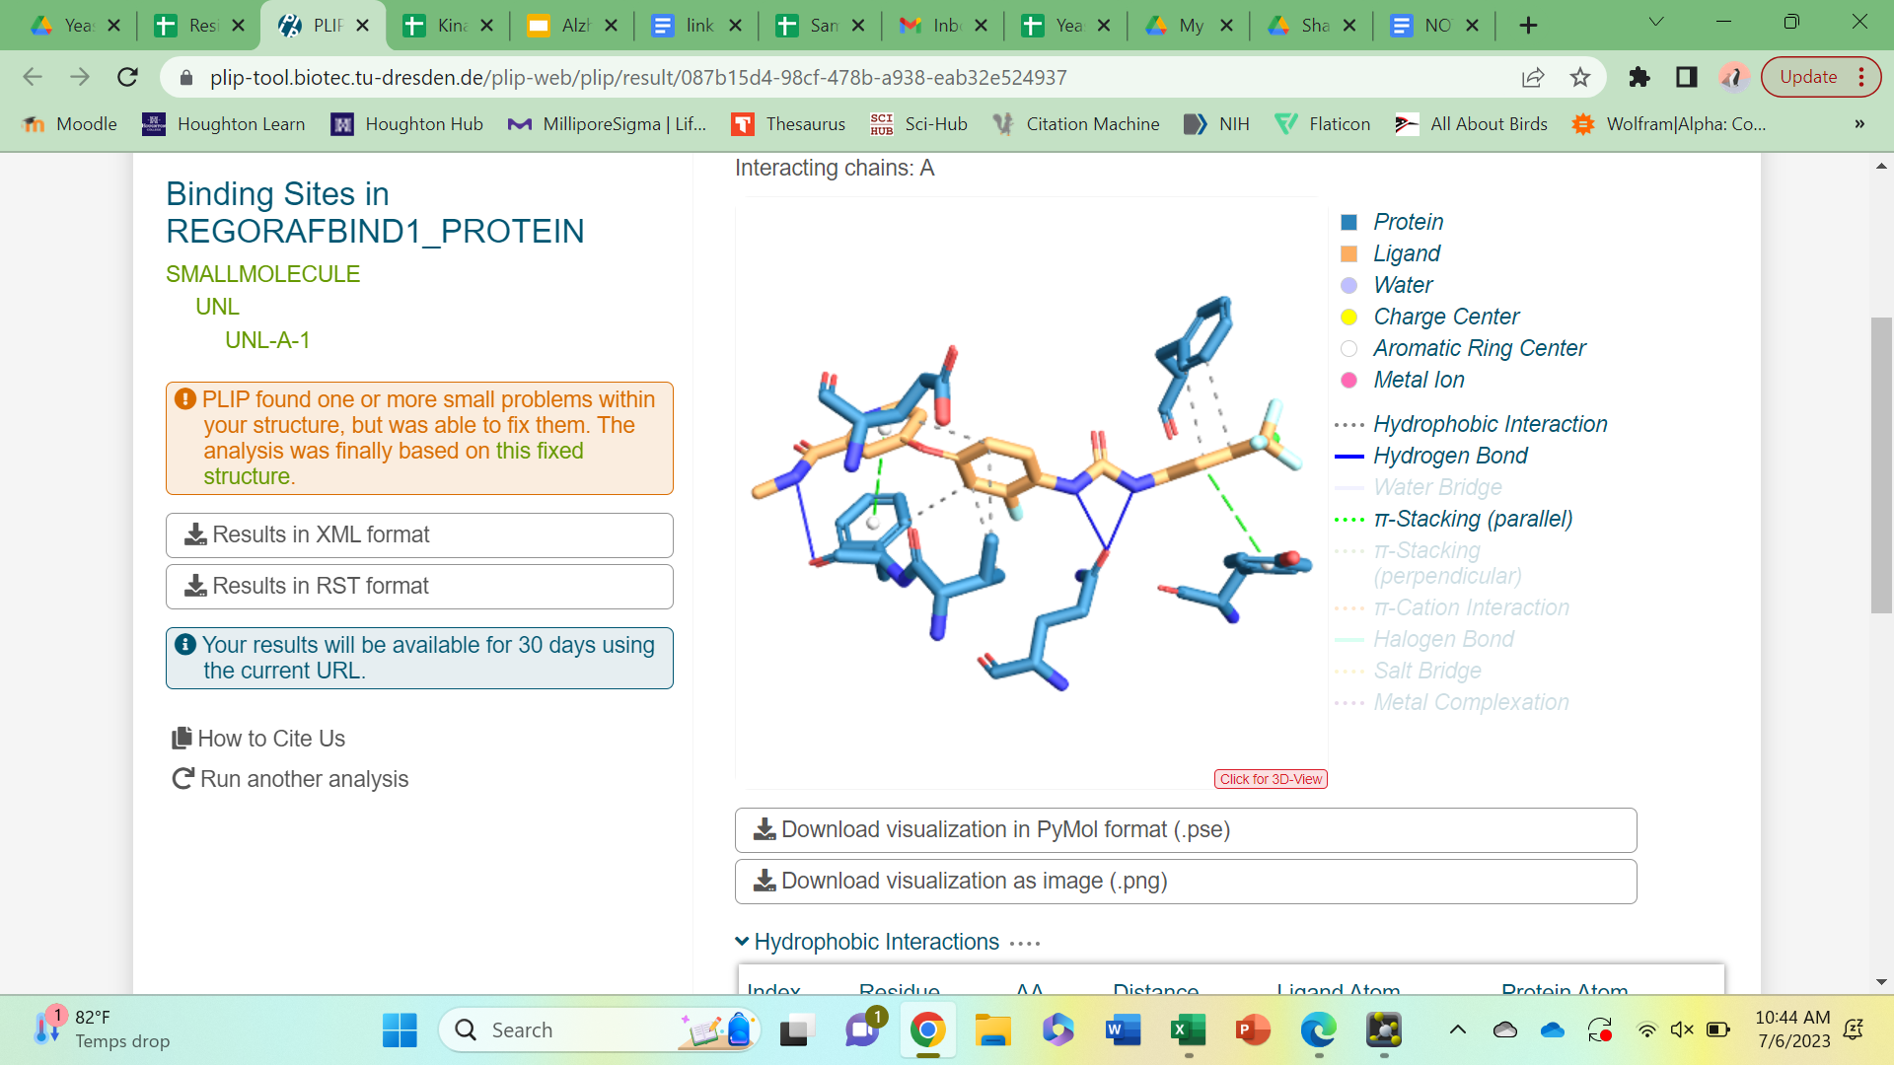
Autodock Vina

Slide 14
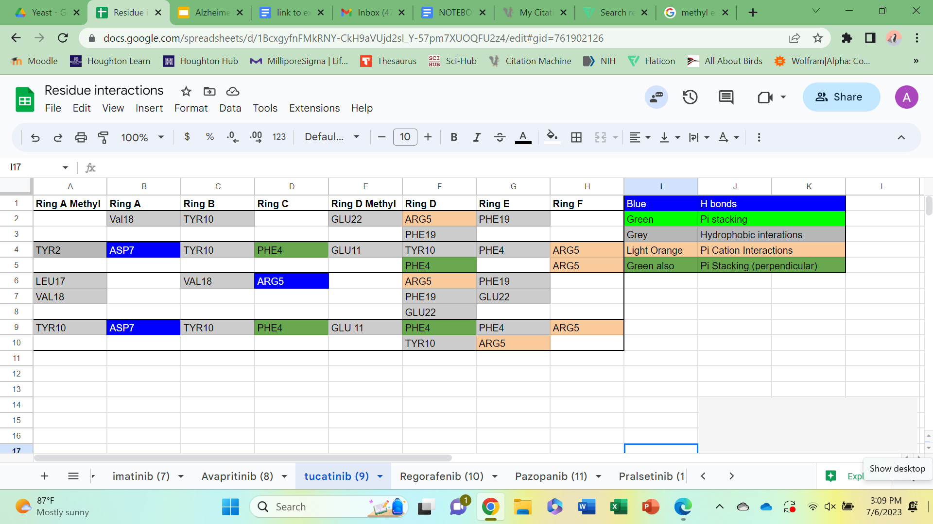
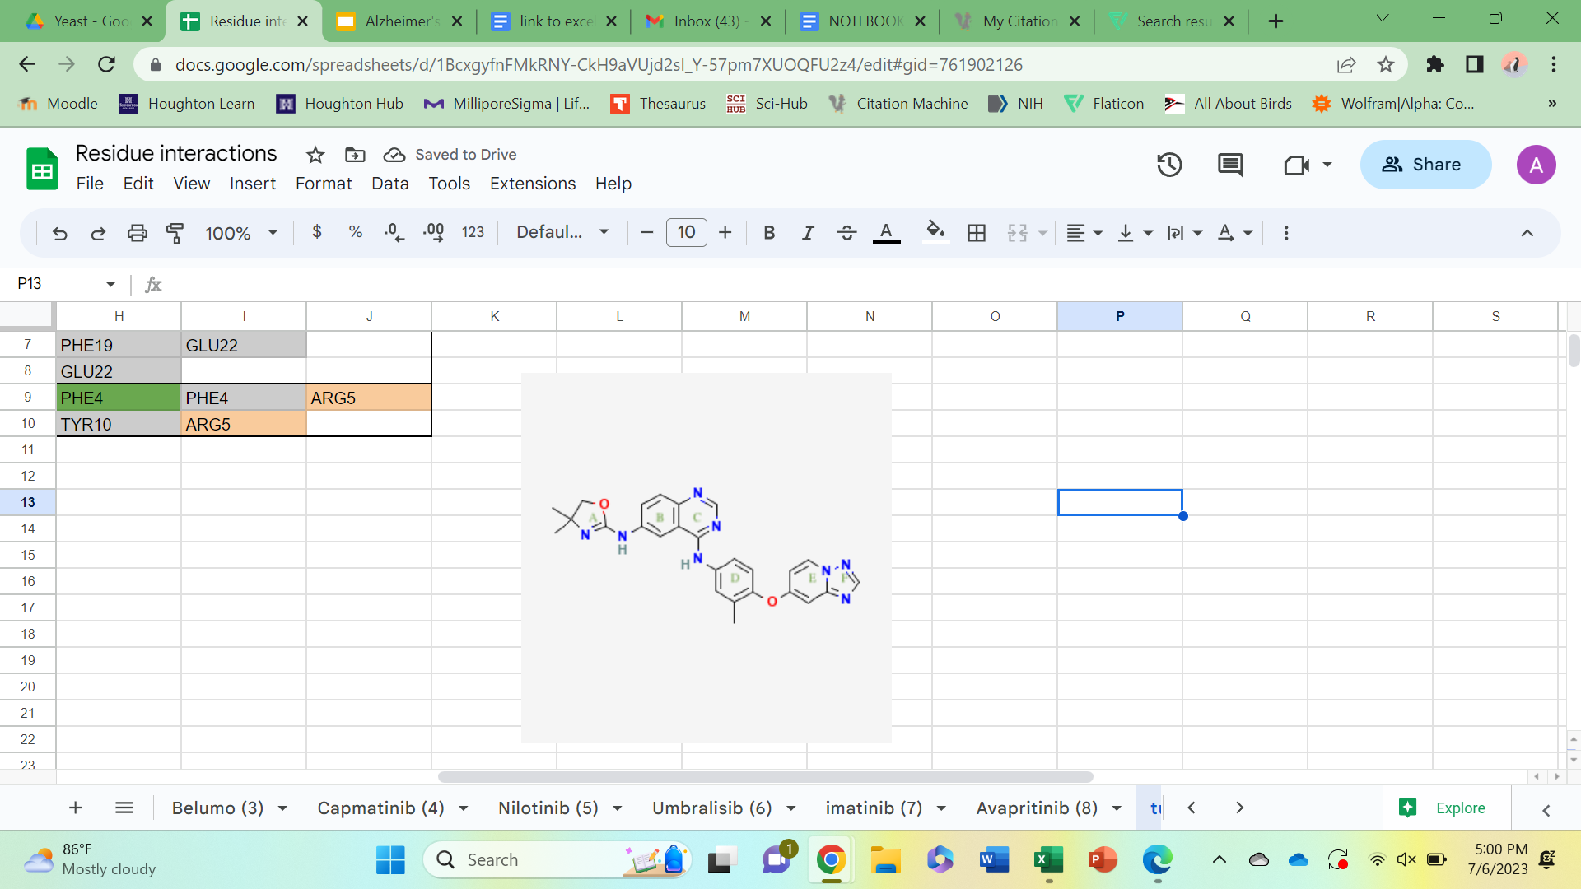
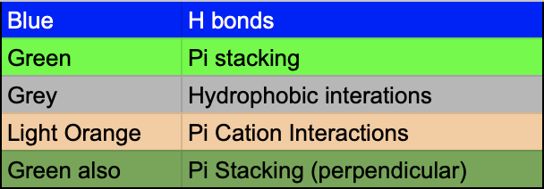
Autodock Vina

Slide 15



MS Labeling Experiments
A way to “paint” proteins
Also called footprinting
Visualize binding interactions and protein shape

Slide 16
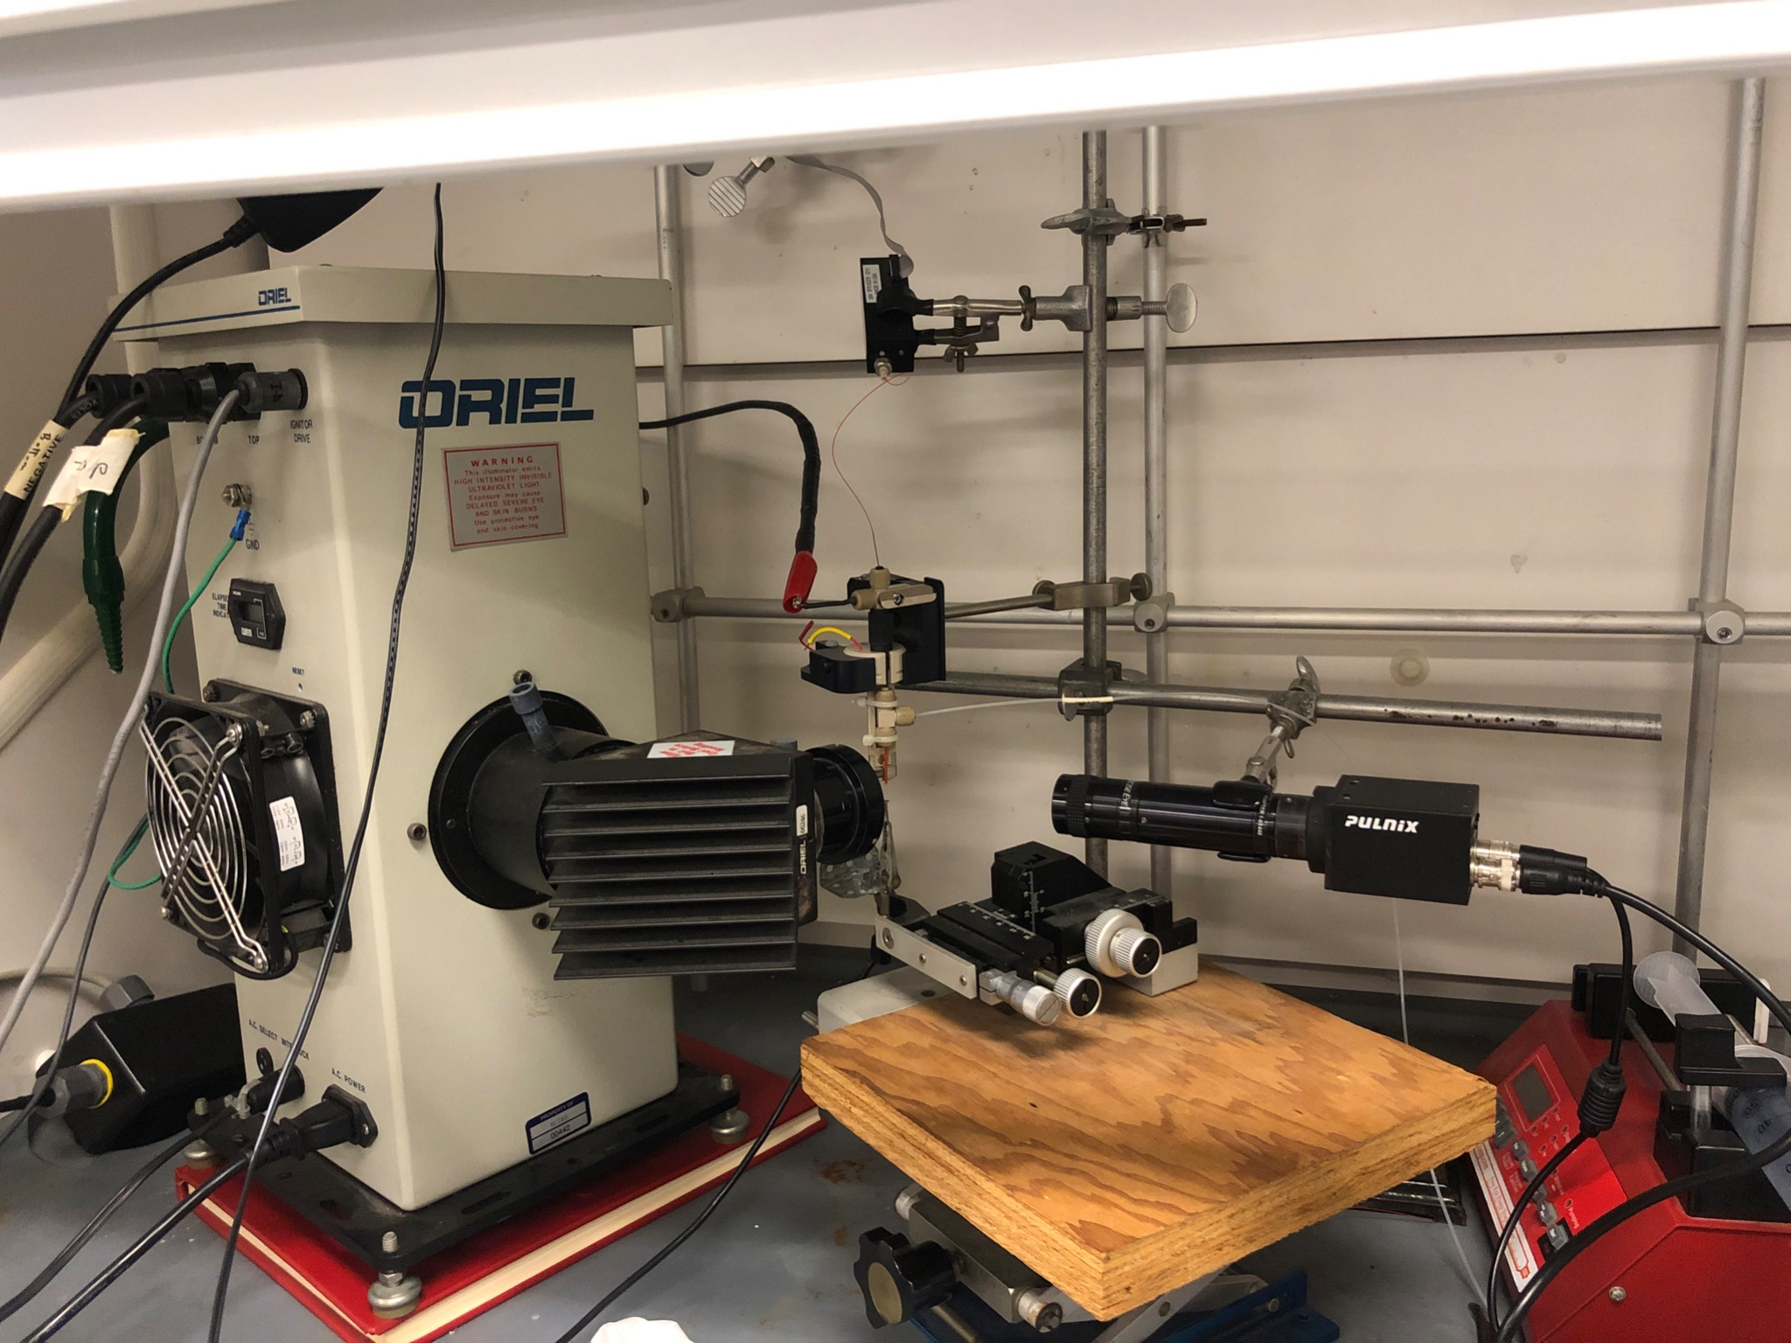
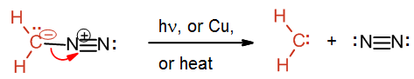
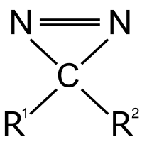
Labeling performed in the gas phase through nanospray device
Carbene “paints” protein
H
H
Welker, M. (n.d.). Organic Chemistry II. 10.7. Additions involving cyclic intermediates | Organic Chemistry II. https://courses.lumenlearning.com/suny-potsdam-organicchemistry2/chapter/10-7-additions-involving-cyclic-intermediates/

Slide 17
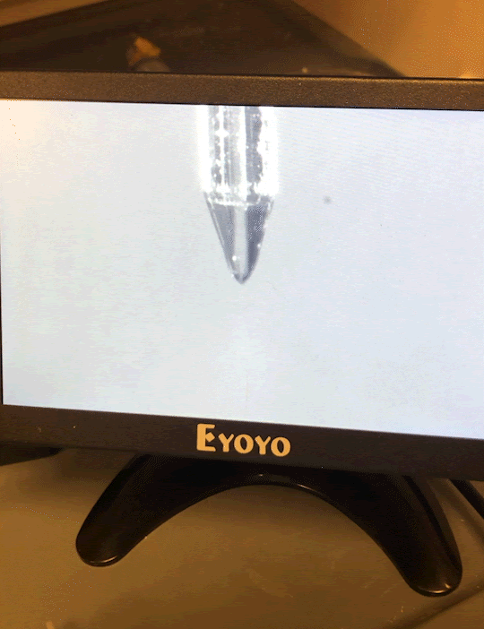
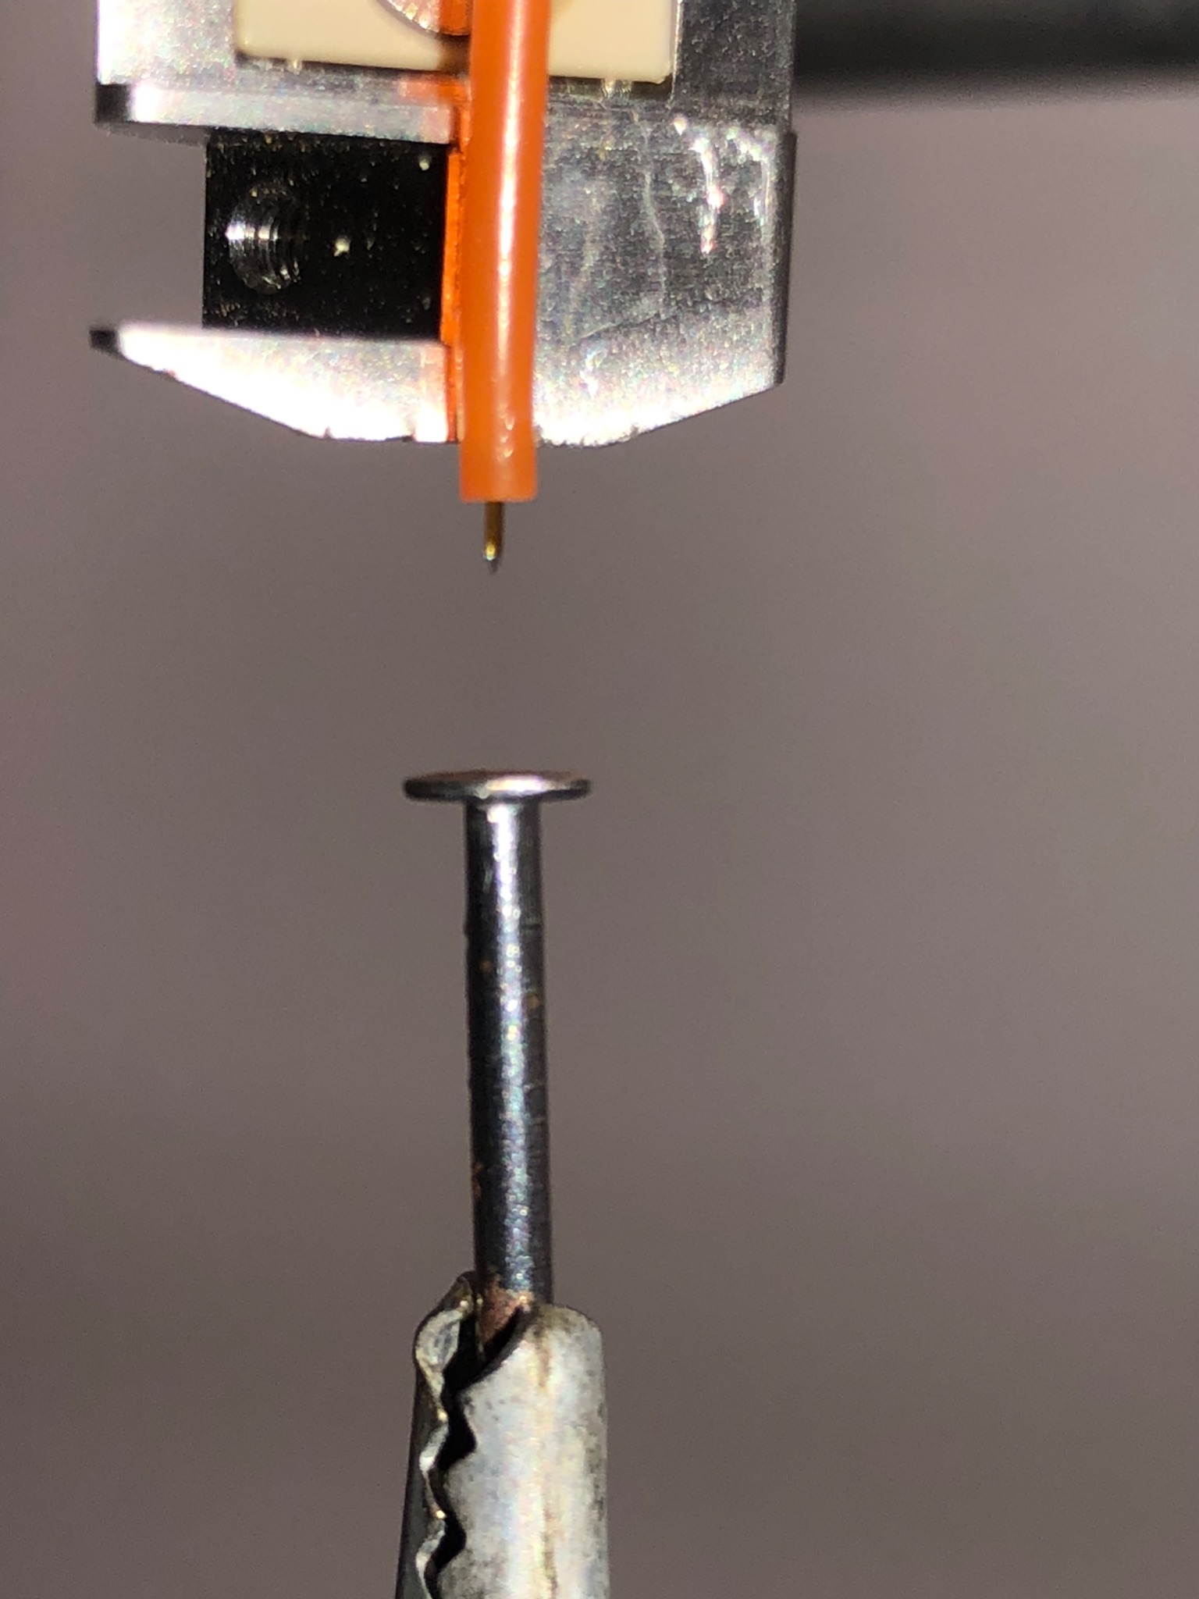

Labeling Experiments
Unlabeled Protein
DZN Gas
UV Light
Carbene Labeled Protein

Slide 18
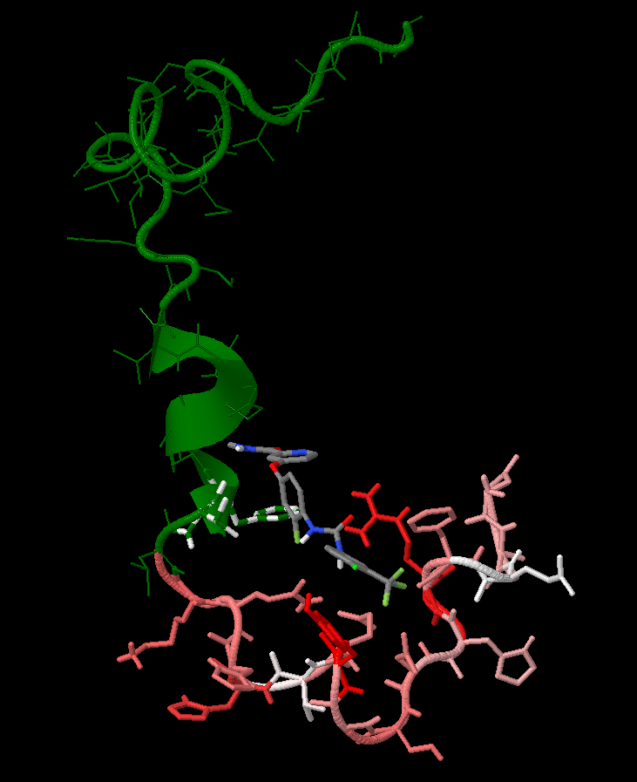
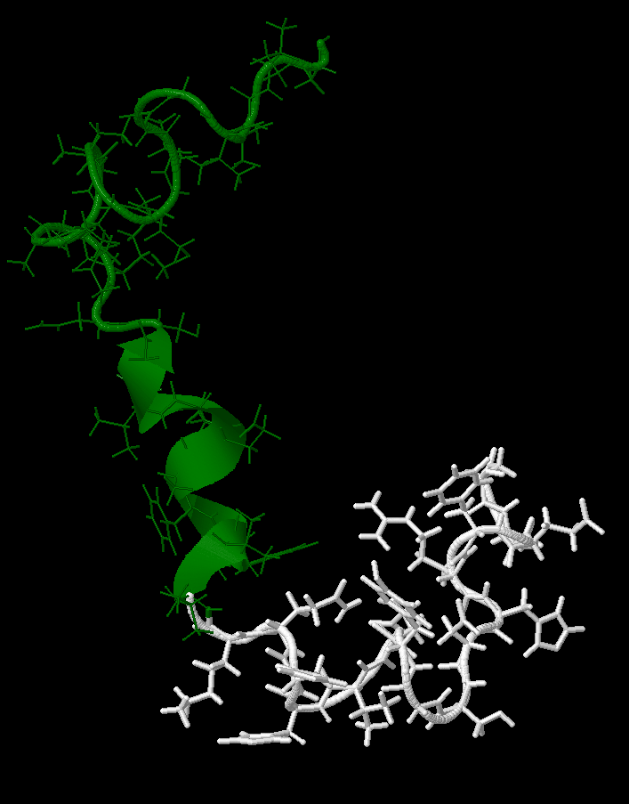
Labeled Results
With Regorafenib
Without Regorafenib

Slide 19

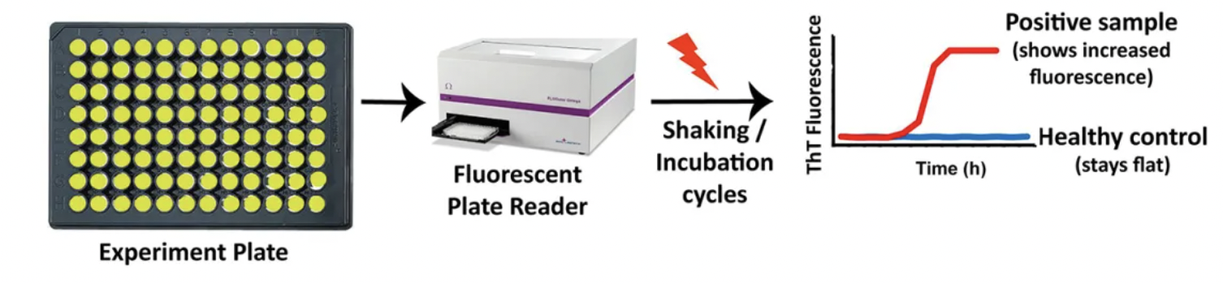

THT Explanation
<a href="https://www.flaticon.com/free-icons/eye-care" title="eye care icons">Eye care icons created by pojok d - Flaticon</a> <a href="https://www.flaticon.com/free-icons/bottle" title="bottle icons">Bottle icons created by Freepik - Flaticon</a> Protein test could lead to earlier and better diagnosis of Parkinson’s (2021, December 13th, Retrieved July 6th, 2023, NUFFIELD DEPARTMENT OF CLINICAL NEUROSCIENCES Medical Sciences Division, from https://www.ndcn.ox.ac.uk/news/protein-test-could-lead-to-earlier-and-better-diagnosis-of-parkinsons

Slide 20
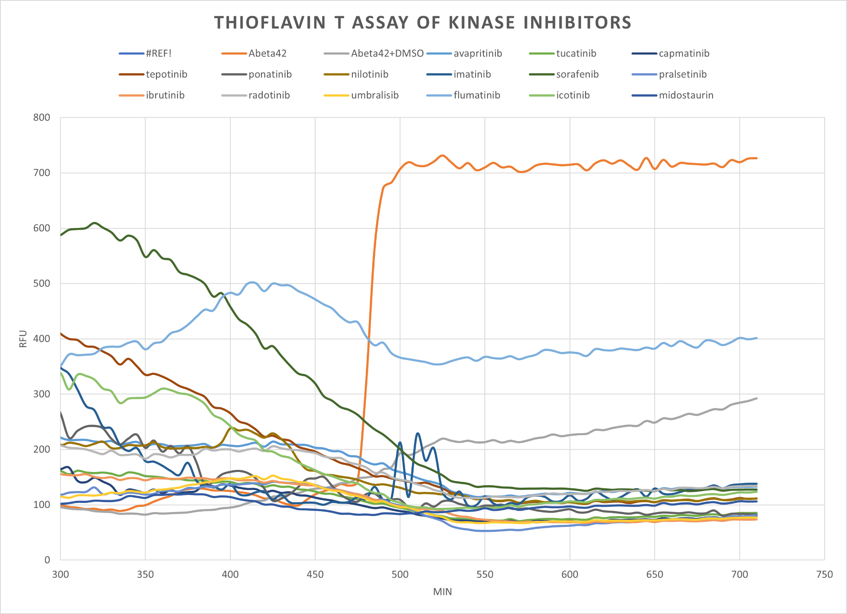

Slide 21
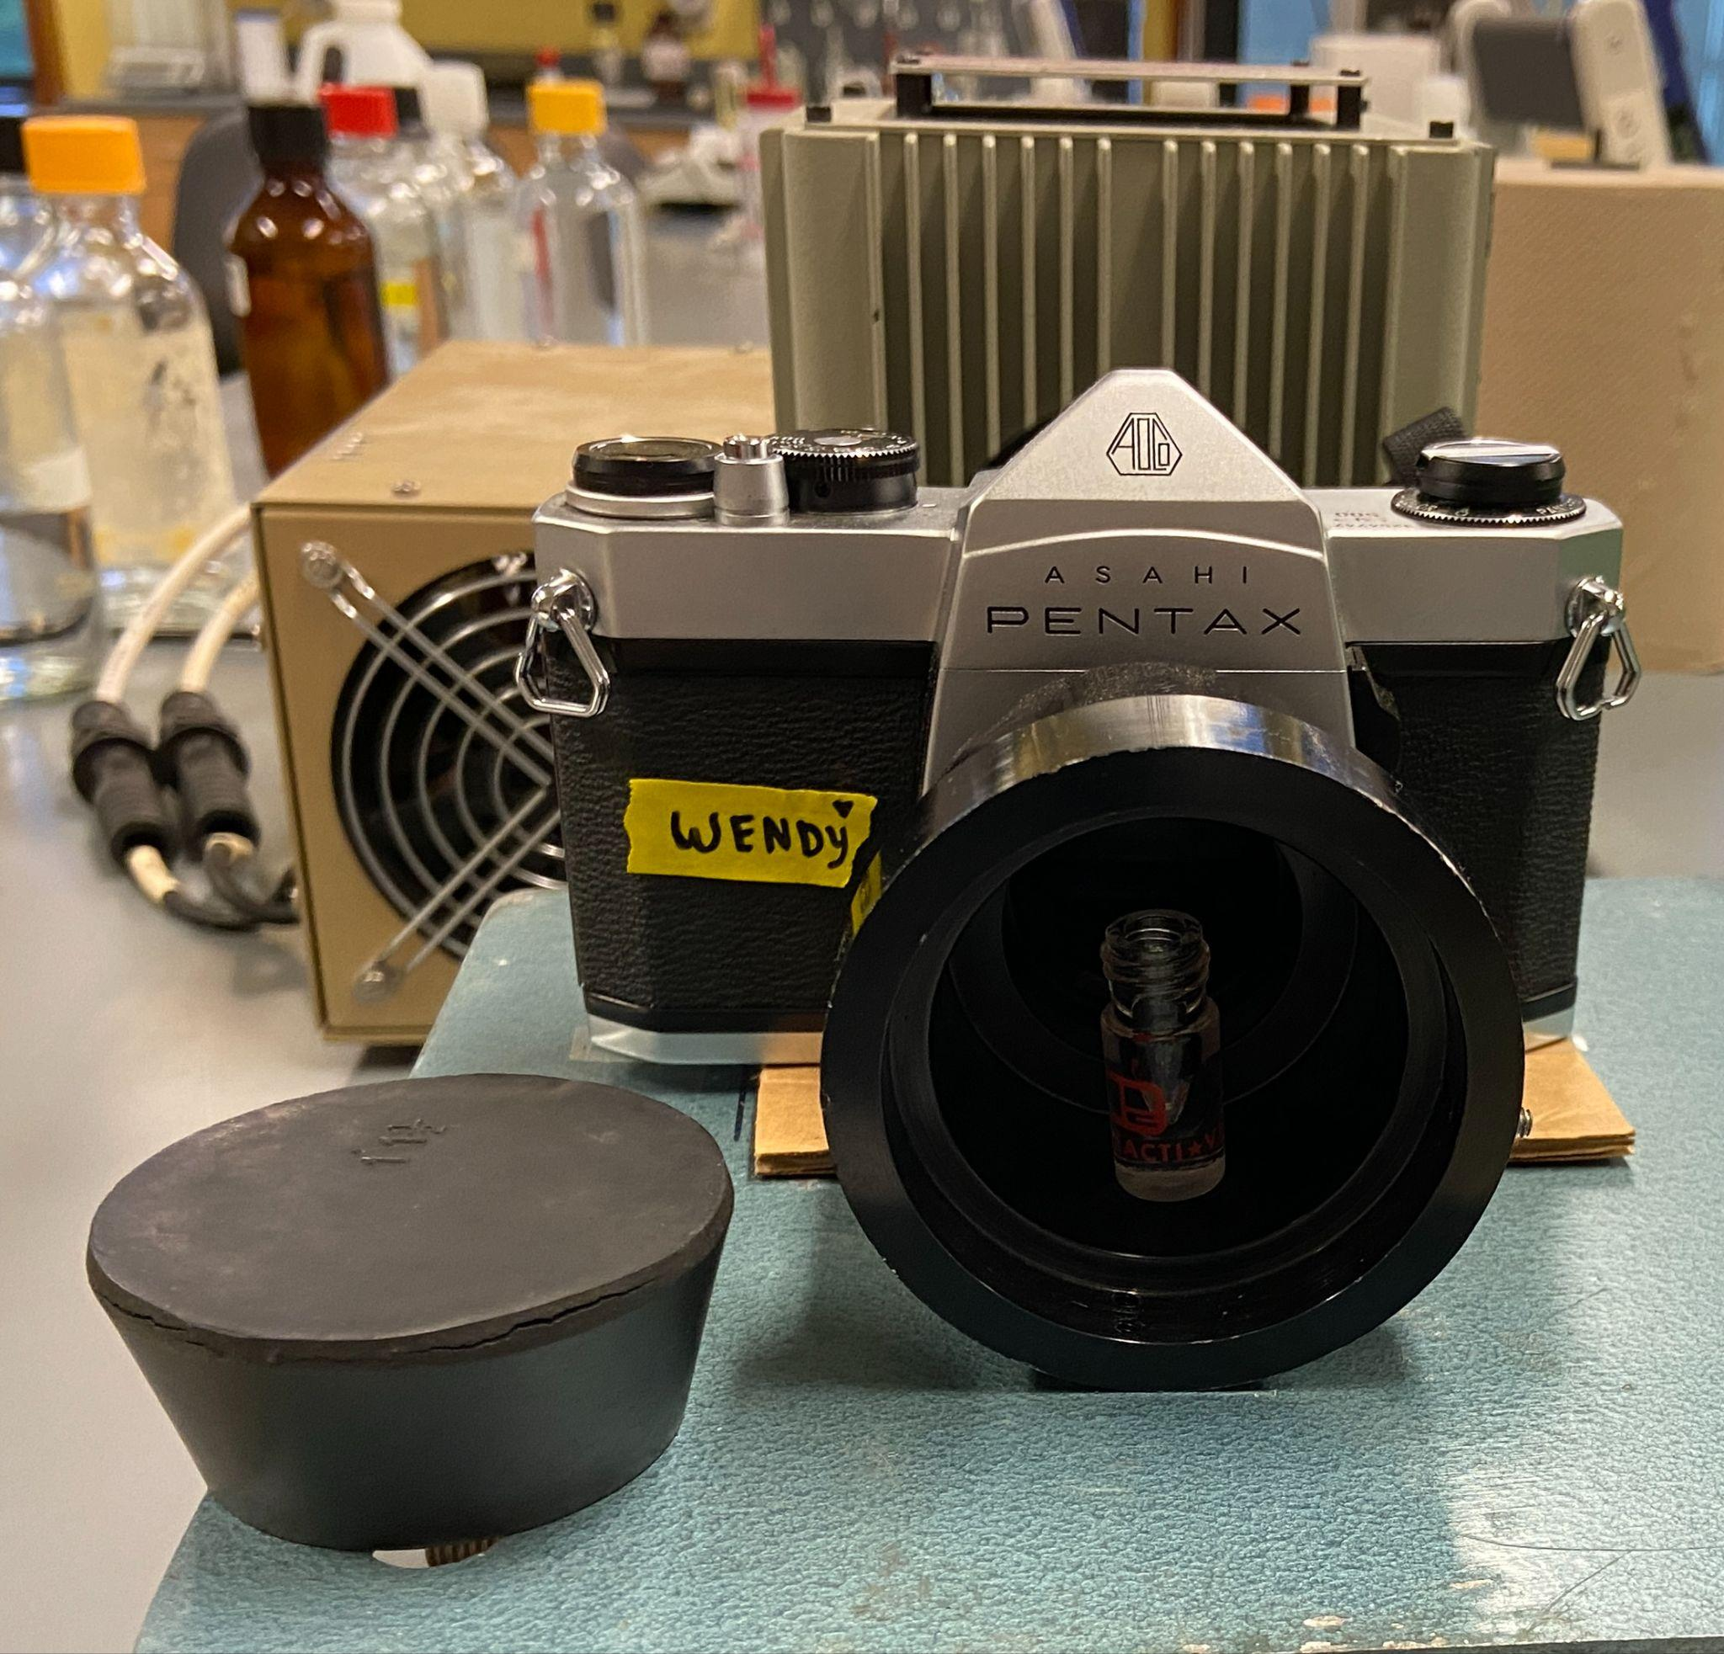
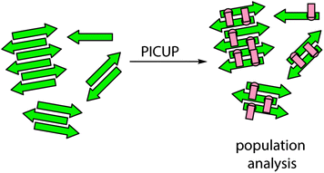
PICUP Procedure
George W. Prestonab & Andrew J. Wilson (2013, February 13th) Photo-induced covalent cross-linking for the analysis of biomolecular interactions. Retrieved July 3rd, 2023, from https://pubs.rsc.org/en/content/articlehtml/2013/cs/c3cs35459h

Slide 22
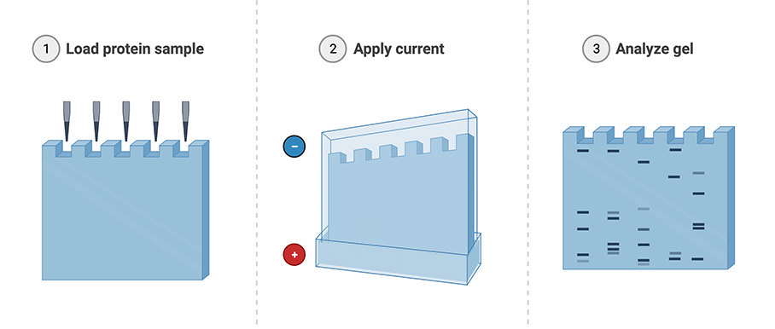
SDS-PAGE Gels
Rockland Resource Library SDS-PAGE Technique, from https://www.rockland.com/resources/sds-page-technique/

Slide 23
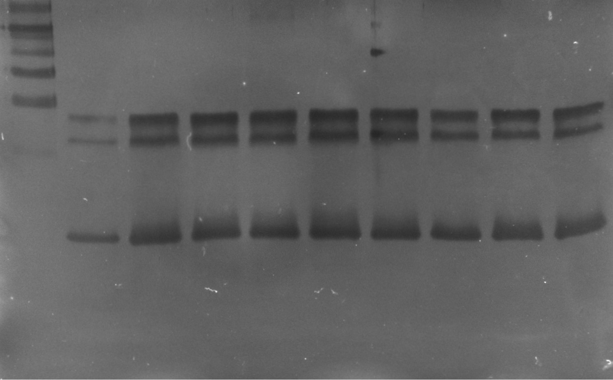
PICUP Results
Ladder
Reg 19 uM
Control
Vehicle
Control
Reg 9.0 uM
Reg 19 uM
Reg37 uM
Reg 74 uM
Reg37 uM
Reg 74 uM
Primary
Secondary
Tertiary

Slide 24
Adaptations to PICUP
Staining Solutions were remade
Bad Milli-Q Water
Low rate of Aggregation in controls
Varying incubation times
Expired Regorafenib
New Regorafenib
Low Regorafenib Concentration
Increased Regorafenib Concentration
Low Protein Concentration
Increased Protein Concentration
High Protein Concentration
?
Old Peptide
New Peptide

Slide 26
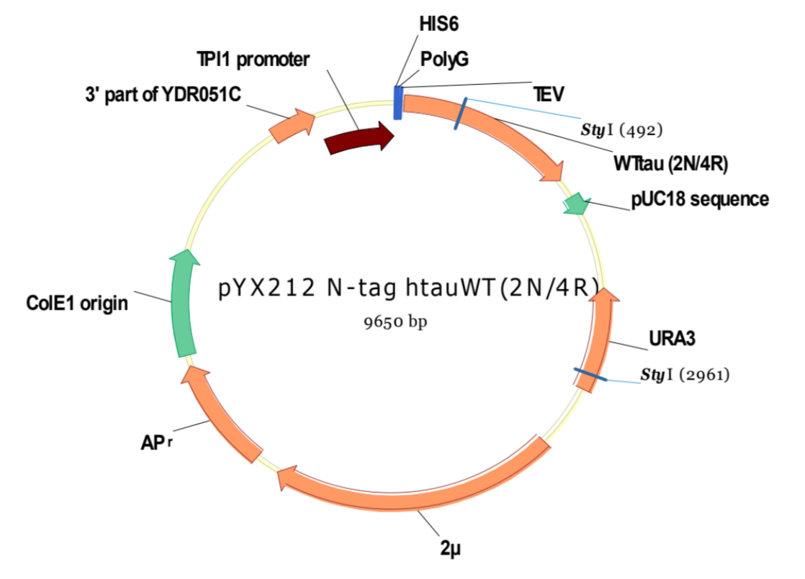
Engineered Yeast Model
Graphic courtesy of Winderickx lab

Slide 27
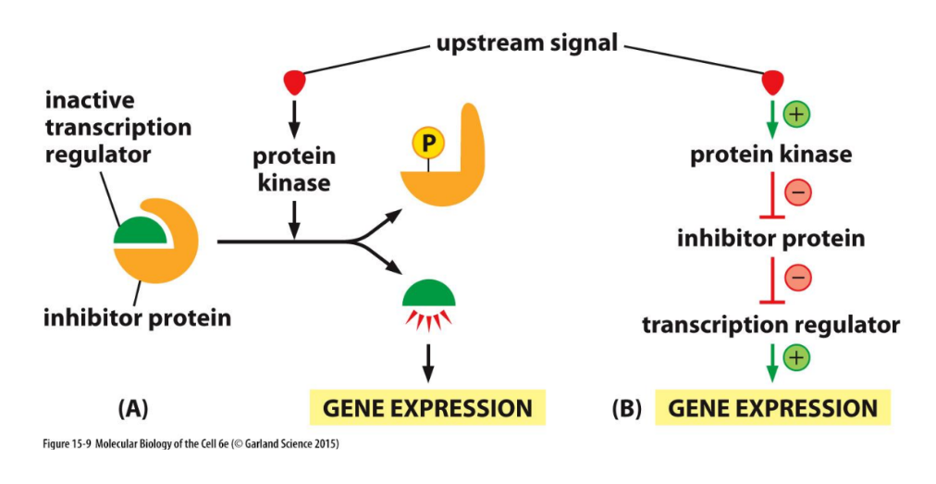
Kinase Cascades

Slide 28
Prospective Human Kinase Orthologs
Yeast has 173 kinases with a total of 282 unique phosphorylation sites¹
HOG-1→ potential ortholog to MAPK-p38
Protein BLAST e value = 1e-129
4 phosphorylation sites²
STE-20 → potential ortholog to PAK-1
Protein BLAST e value = 2e-147
62 phosphorylation sites³
¹Brinkworth, R. I., Munn, A. L., & Kobe, B. (2006). Protein kinases associated with the yeast phosphoproteome. BMC Bioinformatics, 7(1). https://doi.org/10.1186/1471-2105-7-47
²Tyers Lab. (2023). Saccharomyces Cerevisiae HOG1 Result Summary. BioGRID Search for Protein Interactions, Chemical Interactions, and Genetic Interactions.https://thebiogrid.org/31384/summary/saccharomyces-cerevisiae/hog1.html
³Tyers Lab. (2023). Saccharomyces Cerevisiae STE20 Result Summary. BioGRID Search for Protein Interactions, Chemical Interactions, and Genetic Interactions.https://thebiogrid.org/36419/summary/saccharomyces-cerevisiae/ste20.html

Slide 29
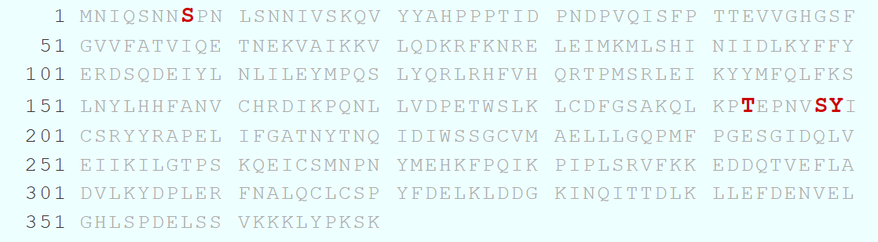
Human Tau Kinase Orthologs
PHO-85 → ortholog to Gsk-3b¹
No phosphorylation sites²
Deletion results in serine hyperphosphorylation at other kinases¹
MDS-1 → ortholog to Cdk-5¹
4 phosphorylation sites³
¹Vandebroek, T., Vanhelmont, T., Terwel, D., Borghgraef, P., Lemaire, K., Snauwaert, J., Wera, S., Van Leuven, F., & Winderickx, J. (2005). Identification and isolation of a hyperphosphorylated, conformationally changed intermediate of human protein tau expressed in yeast. Biochemistry, 44(34), 11466–11475. https://doi.org/10.1021/bi0506775
²Tyers Lab. (2023). Saccharomyces Cerevisiae PHO85 Result Summary. BioGRID Search for Protein Interactions, Chemical Interactions, and Genetic Interactions. https://thebiogrid.org/36147/summary/saccharomyces-cerevisiae/pho85.html
³Tyers Lab. (2023). Saccharomyces Cerevisiae Rim11 Result Summary. BioGRID Search for Protein Interactions, Chemical Interactions, and Genetic Interactions. https://thebiogrid.org/35316/summary/saccharomyces-cerevisiae/rim11.html

Slide 30
Does Regorafenib affect kinase activity responsible for Tau pathology by preventing phosphorylation?

Slide 31


Tau phosphorylation
Determine if engineered yeast can grow in the presence of Regorafenib
Purify Tau from yeast grown in drug and control conditions¹
Develop method for phosphopeptide enrichment
Conduct relative quantification of phosphorylated Tau
¹Winderickx, April 2020

Slide 32
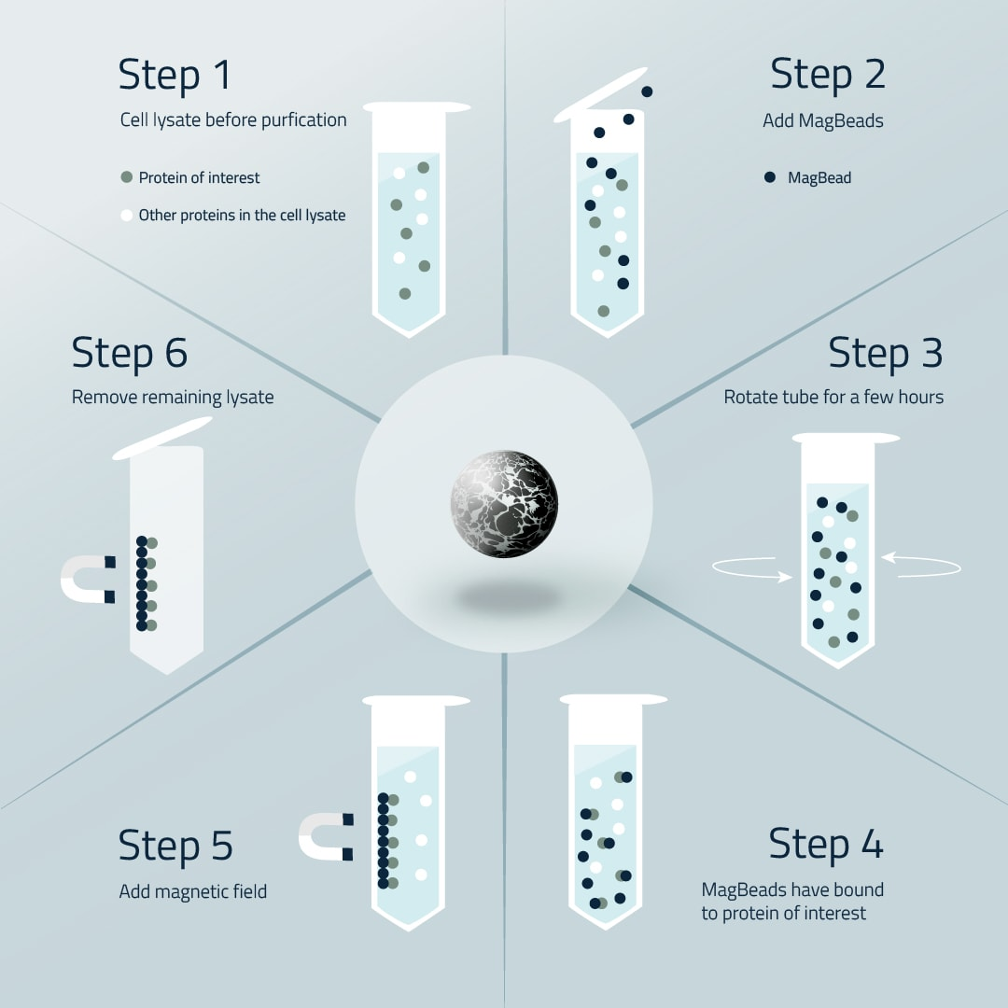
Phosphopeptide Enrichment
Cube Biotech https://cube-biotech.com/media/ce/22/c6/1656666760/Magbead%20Workflow%20small.jpg

Slide 33

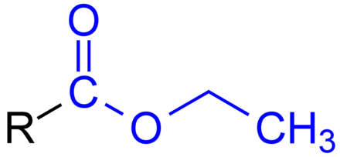
Method Development
Trypsin Digest
Trypsin Digest
Convert acidic tails to methyl esters
Phosphopeptide enrichment
Phosphopeptide enrichment
Convert acidic tails to ethyl esters
Measure on mass spec

Slide 34
Method Development Results
20%
Conducting ethyl esterification after phosphopeptide enrichment improved yield by approximately 20%

Slide 35
Discussion

Slide 36

Relevance
Developing new Methods
And Refining others
Repurposing Medications
Saves Time and Money
Address both Camp’s Problems
Kinase Inhibitors address Tau
Drug that stop aggregation

Slide 37
The Next Step…
Further analysis of high scoring kinase inhibitors
Circular Dichroism
PICUP/SDS-Page
Continue work with TAU isolation and characterization
Assess the role of methionine oxidation on kinase activation

Slide 38
Acknowledgments
Robert Van Dyk and Family
Shannon Summer Research Institute
Biology Department
Dr. Potter
Brandon Bate
Joris Winderickx

